Slide 1

Zomato,
Expansion Project
Tarannum Vaid 15/04/2024

Slide 2
Zomato – a prominent India-based multinational enterprise; a restaurant aggregator and food delivery company.
Founded - 2008
02

Slide 3

The Introduction
Zomato, pronounced as /zoʊmɑːtoʊ/, stands as a prominent player in the food delivery industry. Established in 2008 by Deepinder Goyal and Pankaj Chaddah, it offers a comprehensive platform for users. Beyond merely facilitating food delivery from a vast array of partner restaurants across over 1,000 cities and towns in India, Zomato also serves as a rich resource for restaurant information, menus, and user-generated reviews. As of 2022–23, Zomato finds itself in direct competition with Swiggy, particularly in the realm of food delivery and hyperlocal services.

Slide 4
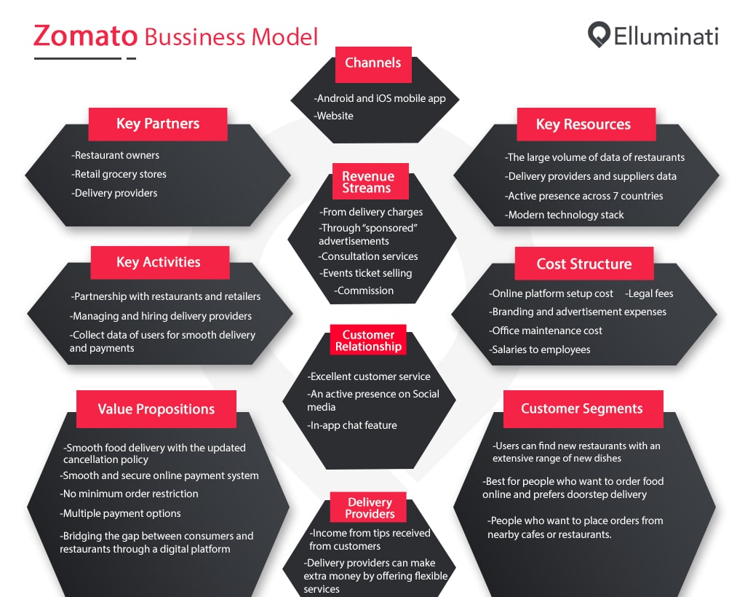
How it works – Business Model
Zomato, a standout startup in India since 2008, has garnered widespread attention for its rapid growth and profitable model, even amid offering attractive discounts. Its core function revolves around suggesting local eateries to users and facilitating orders, leveraging ratings and reviews for informed choices. This simplicity and effectiveness have piqued the interest of entrepreneurs looking to emulate its success.
By seamlessly connecting users with restaurants and delivery providers, Zomato elevates both user convenience and local businesses, all within a streamlined process: users browse, order, restaurants prepare, delivery providers dispatch, and customers pay and review.
Source: Elluminati

Slide 5
Data Cleaning & Pre-processing
Data Overview
Initially, the opening year was extracted from the 'datekey_opening' column to facilitate the handling of year-based inquiries. Subsequently, blank entries in the 'cuisines' column were eliminated to enhance data cleanliness and mitigate the risk of inaccuracies.
The ‘Raw Data’ Excel sheet initially comprised 12 categorical and 8 continuous columns. However, following pre-processing, this arrangement was adjusted to 14 categorical and 12 continuous columns, respectively. Additionally, leveraging information from the 'country description' sheet, country names were integrated into the raw data sheet to uphold data coherence. Moreover, utilizing exchange rates, currencies from all countries were standardized to INR to ensure data consistency.
Insights gleaned from price range, restaurant ratings, and country-specific data offer valuable guidance for the expansion strategy and its subsequent execution.
Initially, there were two tables: Raw Data and Country Description. However, following analysis, the number of pivot tables has increased to 14, accompanied by 4 additional regular tables, 14 charts, and a dashboard.
Number of Restaurants: 9542
Territorial Encompassment: 15 nations and around 150 cities globally.
Number of Attributes: Originally 20 columns, then 26.

Slide 6


Analytical Methodologies and Instruments
For Data Cleaning – Used functions like LEFT, Remove Duplicates, Filter and Remove were used for data cleanliness.
For Data Enhancement – VLOOKUP, IF AND, SUM, ARRAYFORMULA, & COUNTIFS were used.
Pivot Tables were utilized to condense essential metrics and unveil patterns across various aspects such as quality, ratings, expenses, competition, and more.
Competitive as well as Statistical Analysis was carried out to predict which countries and cities would be most suited to expand in.
Visualization - Developed dynamic charts and interactive dashboards to visually represent data, facilitating engaging and interactive exploration of information.

Slide 7
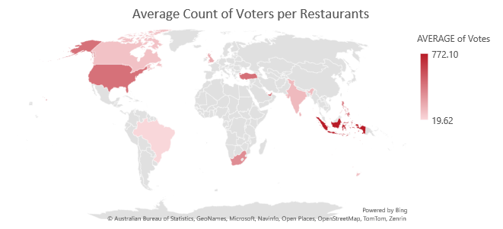
Basic Analysis
Restaurant Count
Per the data, the total number of restaurants opened were 9542, out of which, maximum ones opened in India (8652) and the minimum in Canada (4). In the year 2018, most of the restaurants had their openings.
Price Range, and Voters
The data reveals that the highest price range is marked as 4, with 388 restaurants falling within this category in India. Additionally, the highest average voter count was observed in Indonesia.

Slide 8

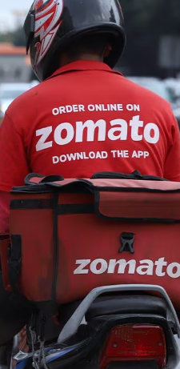


Competitive Analysis
Australia | Canada | Indonesia | Singapore | Sri Lanka
Lesser Competition
Selected countries have lower-rated existing restaurants, offering opportunity through superior quality.
These nations have fewer restaurants, resulting in reduced competition and potentially higher footfall.
Reduced competition increases likelihood of attracting customers and establishing brand presence.
Rating Quality and Expenditure
Most restaurants in the selected countries have lower ratings overall, with exceptions.
Indonesia has the highest average ratings.
Canada and Singapore have the lowest average ratings.
Singapore has the highest maximum expenses among the chosen countries.
Canada and Sri Lanka have the lowest expenses among the five suggested nations.

Slide 9
Most Competitive Restaurants
Restaurant Name | Average of Rating
1918 Bistro & Grill | 4.4
Al'frank Cookies | 4.2
Lake House Restaurant | 4.3
Ministry of Crab | 4.9
Simply Strawberries By Jagro | 4.5
Sushi Masa | 4.9
Talaga Sampireun | 4.9
Grand Total | 4.66
Restaurant-Wise Competition
The restaurants Ministry of Crab, Sushi Masa, and Talaga Sampireun stand out as the most competitive, boasting an impressive rating of 4.9.
Conversely, the least rated establishments among the suggested countries are Elite Indian Restaurant in Sri Lanka and Poets Cafe in Australia.
Least Rated Restaurants
Average of Rating | Countries
Row Labels | Australia | Sri Lanka | Grand Total
2-3 | 2.63 | 2.45 | 2.56
Elite Indian Restaurant |  | 2.40 | 2.40
Pier 70 | 2.60 |  | 2.60
Poets Cafe | 2.40 |  | 2.40
Queen's Cafe |  | 2.50 | 2.50
Star Buffet | 2.90 |  | 2.90
Grand Total | 2.63 | 2.45 | 2.56

Slide 10
Specialities
The cuisines that consistently received high ratings across all five countries are:
Asian, Indonesian, Western
Cafe, Italian, Coffee and Tea, Western, Indonesian
Desserts, Bakery, Western
Seafood
Sunda, Indonesian
Sushi, Japanese
Among these, the cuisine with the highest average rating of 4.90 is Italian, making it the most liked cuisine across the five countries.
Cuisines that stood out
Certainly, the selection of cuisines significantly impacts ratings, as higher ratings tend to attract more visitors, thereby translating into increased sales and profits. Highly rated restaurants also benefit from enhanced reputation, competitive advantage, and pricing flexibility.

Slide 11
01
Reservations v. Online Delivery
Types | Online Delivery
Table Bookings | No | Yes | Grand Total
No | 6377 | 2016 | 8393
Yes | 723 | 435 | 1158
Grand Total | 7100 | 2451 | 9551
Based on the current data, prioritizing table bookings and online delivery services could prove advantageous for the team. In present context, there's a prevalent preference for ordering food at home.
02
However, it's noteworthy that only a small fraction, around 7-8% of the mentioned restaurants, currently offer online delivery. Whether this offering impacts customer ratings remains uncertain, as ratings tend to rely more on factors such as food quality, pricing, ambiance, and service quality, rather than solely on delivery options.

Slide 12
Cuisine-Wise Rates v. Ratings
Rates v. Ratings
Maintaining higher prices for cuisines appears to be a strategic imperative, as indicated by our data analysis. It is discernible that there exists a positive correlation between pricing and restaurant ratings.
Correlation of Rates and Ratings
Specifically, our analysis reveals a correlation coefficient of approximately 0.81, signifying a strong and statistically significant relationship between these variables. In simpler terms, this suggests that as prices increase, so do ratings. Therefore, there is compelling evidence to support the assertion that higher rates indeed lead to higher ratings in restaurants.

Slide 13
Price Range Distribution
Based on the price range distribution across restaurants in the respective countries, it's evident that prices typically range from 1 to 4. Among the 89 total restaurants across the five countries, Australia stands out, with all four of its restaurants offering a price range lower than 500 INR. Conversely, Indonesia distinguishes itself as the only country without any restaurants falling into the highest price range category of 4.

Slide 14
Suggestions and their reasons.
The countries were suggested based on strategic considerations:
Lower competition: These nations offer reduced competition within the restaurant industry, providing an advantageous landscape for new ventures.
Lower ratings: With fewer restaurants boasting high ratings, there's an opportunity to stand out and capture market share more easily.
Fewer restaurants: The limited number of existing establishments indicates potential demand outweighing supply, increasing the likelihood of success for new ventures.
Research is paramount:
Successful ventures hinge on thorough research and understanding of the target areas.
Factors such as local preferences, demographics, and economic indicators must be carefully evaluated.
Consideration of costs, ratings, and other relevant metrics is crucial in determining the viability and potential success of a new venture.
Why suggest these?
Australia
Canada
Indonesia
Singapore
Sri Lanka

Slide 15
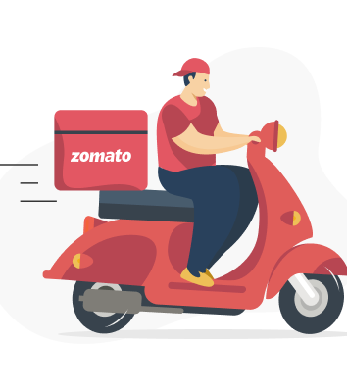
zomato
DASHBOARD

Slide 16
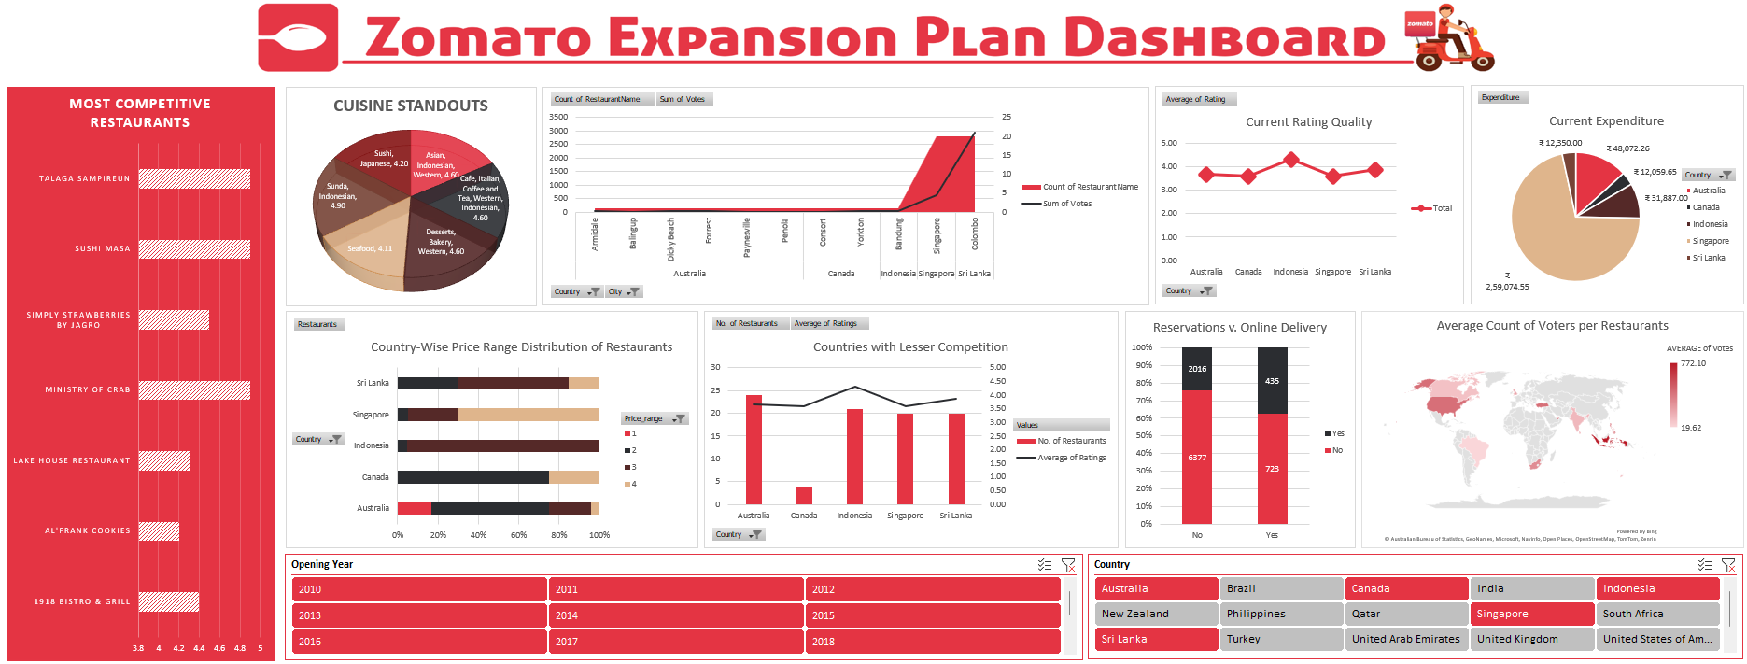

Slide 17

Conclusion
In conclusion, Zomato's data-driven approach has revealed crucial insights guiding its expansion strategy. By prioritizing markets with lower competition, ratings, and restaurant numbers, Zomato can capitalize on untapped potential and establish a competitive edge. The correlation between pricing and ratings underscores the strategic importance of pricing strategies in enhancing customer perception. Through thorough research and understanding of local preferences, Zomato can be positioned to capitalize on emerging opportunities and drive sustainable growth in the dynamic food delivery landscape.

